Slide 1

Utilization of slags for development of fire resistant geopolymers
National Technical University of Athens
School of Mining and metallurgical engineering
Laboratory of metallurgy
Prof. D. Panias
Dr. K. Sakkas
Dr. I. Giannopoulou
Slag Valorization Symposium 2019

Slide 2

Research Motives
Utilization of slags produced from two different European metallurgical companies as precursors for production of Fire Resistant Geopolymers for passive fire protection of concrete constructions

Slide 3
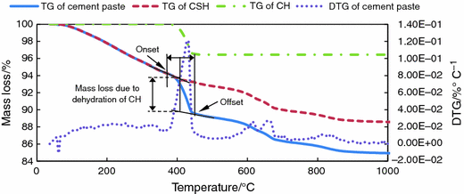

What’s the fire effect on concrete constructions?
(a) pore pressure rising due to evaporating water
(b) compression of the heated surface due to a thermal gradient
(c) internal cracking due to difference in thermal expansion between aggregate and cement paste;
(d) cracking due to difference in thermal expansion/deformation between concrete and reinforcement rebars
(e) strength loss due to chemical transitions
Dehydration of concrete
380ºC
500ºC
Concrete Spalling

Slide 4
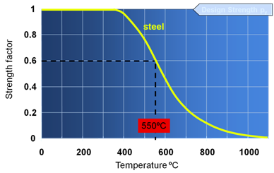
What’s the fire effect on steel rebars?
Design Strength
Substantial loss of mechanical strength due to heating caused by fires
Effect of temperature on mechanical strength
of hot rolled structural steel

Slide 5
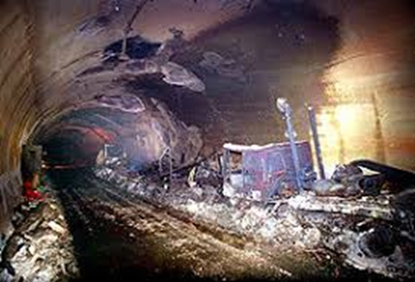
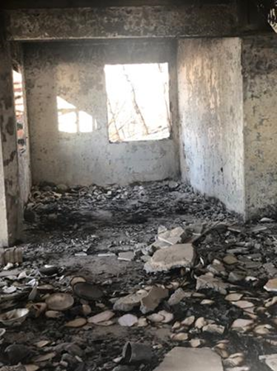
Collapse of concrete constructions due to fire events
Eastern Attica, Greece summer Fire - 2018
Mont Blanc tunnel fire, 1996

Slide 6

How does a fire resistant materials work ?
≤ 380ºC
Concrete
Fire Resistant Lining
Structural steel rebars

Slide 7
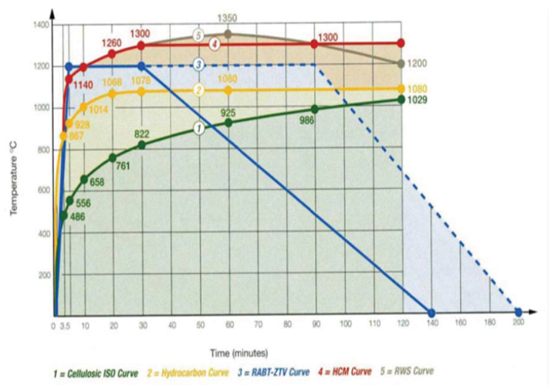
Specifications for fire resistant geopolymers
To resist either to ISO-834 cellulosic fire or to RABT simulated fire incidents
Compressive strength > 2MPa
Density 800-1400 kg/m³

Slide 8
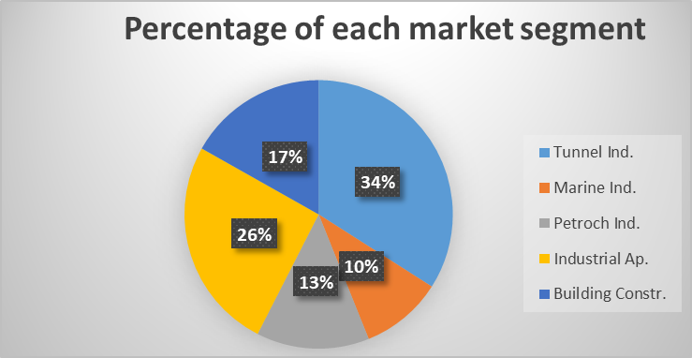
Market Size of Fire Resistant Materials
Worldwide passive fire protection market is expected to reach 7.13 billion US dollars by 2022
According to numerous studies the annual revenues of the European passive fire protection market follows a steady growing rate expected to reach 1.57 billion US dollars by 2022

Slide 9
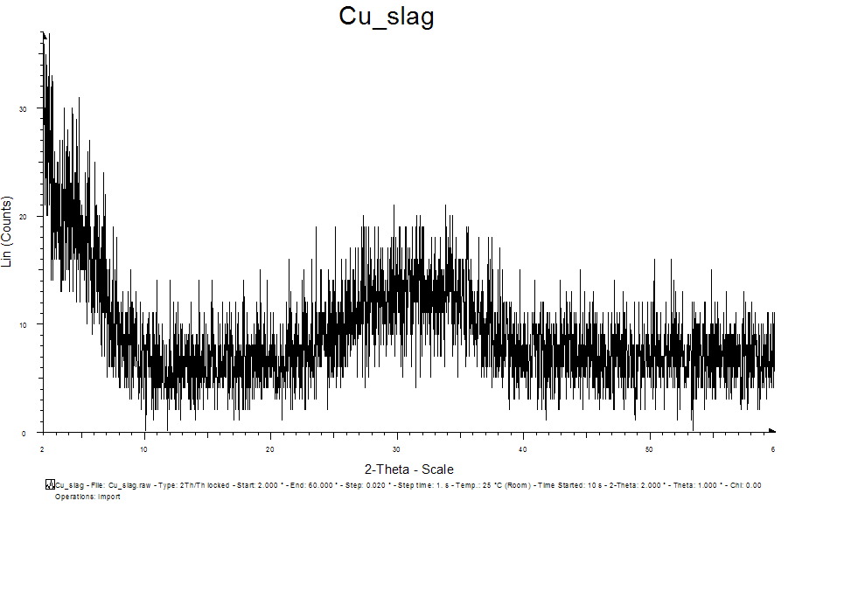
RAW MATERIAL-1: Slag from BOLIDEN
Component | %
FeO | 44,51
Al2O3 | 3,30
SiO2 | 39,88
TiO2 | 0,82
Na2O | 0,60
CaO | 4,08
SO3 | 1,19
P2O5 | 0,21
Cr2O3 | 0,25
ZnO | 1,77
MgO | 1,47
Totally amorphous Fayalitic slag

Slide 10
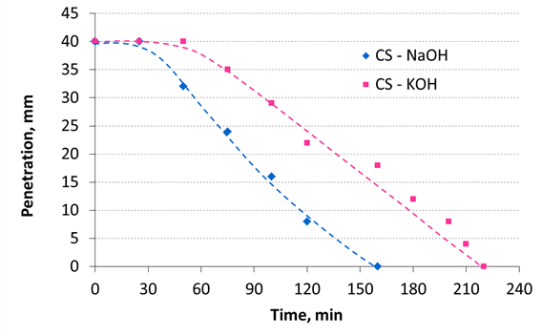
Synthesis Conditions for ISO-834 fires
Synthesis Conditions
Activator | KOH – 8M
Slag/Activator Ratio | 6 g/mL
Foaming Agent | Al powder – 0,23% w/w
Setting at ambient Temperature
The paste sets at ambient temperature after 3,5 hours

Slide 11
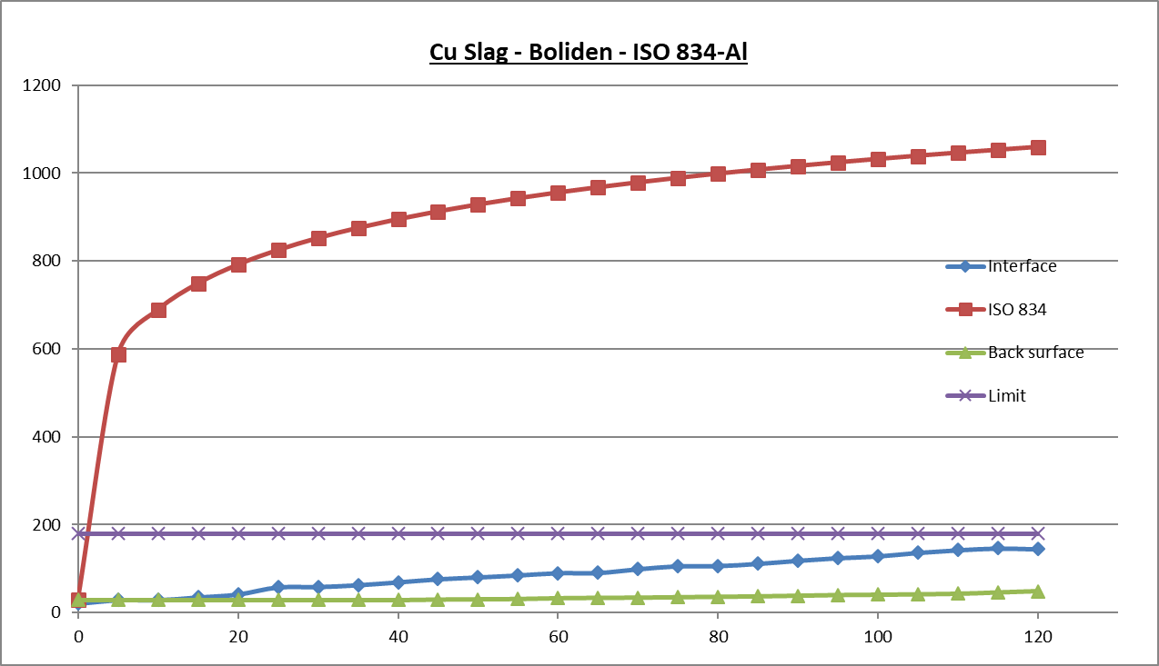
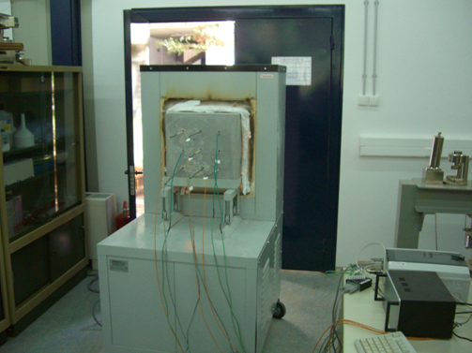
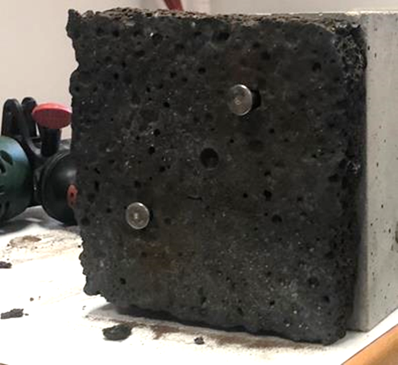
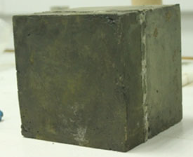

Materials Properties
Compressive strength = 3 MPa
Apparent Density = 1060 kg/m³
Fire Resistance Test (EFNARC Guidelines)
Composite Specimen
40cm
Concrete Substrate
Rectangular Specimen
40 x 40 cm
with Thickness 15cm
Geopolymer Lining
Rectangular Specimen
40 x 40 cm
with Thickness 2cm
Fire Resistant Anchors
40cm
Temperature gradient : 44 °C/mm
No Damages
Only a small superficial crack
Max temperature at the concrete/geolopolymer interface is 160 °C which is lower than the test success limit of 180 °C
15cm
2cm
After Fire Test

Slide 12
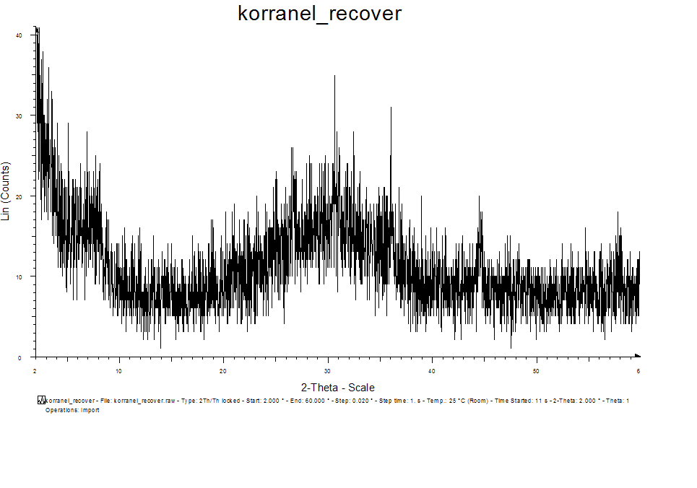
RAW MATERIAL-2: Slag from Metallo
Component | %
FeO | 41,65
Al2O3 | 8,47
SiO2 | 31,77
TiO2 | 0,82
Na2O | 2,22
CaO | 4,63
SO3 | 0,92
P2O5 | 1,71
Cr2O3 | 1,38
ZnO | 1,14
MgO | 1,46
F: Fayalite Fe2SiO4
C: Clinoferrosilite FeSiO3
C
F
C
Totally amorphous Fayalitic slag
F

Slide 13
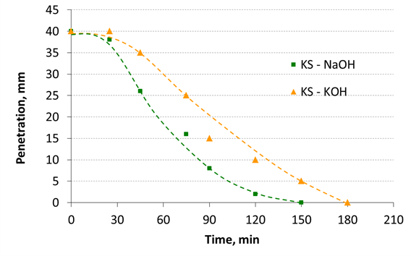
Synthesis Conditions for RABT fires
Synthesis Conditions
Activator | KOH – 9M
Slag/Activator Ratio | 3,6 g/mL
Foaming Agent | Al powder – 0,09% w/w
Fluxes added | Al2O3 – 20% w/w
Setting at ambient Temperature
The paste sets at ambient temperature after 3 hours

Slide 14
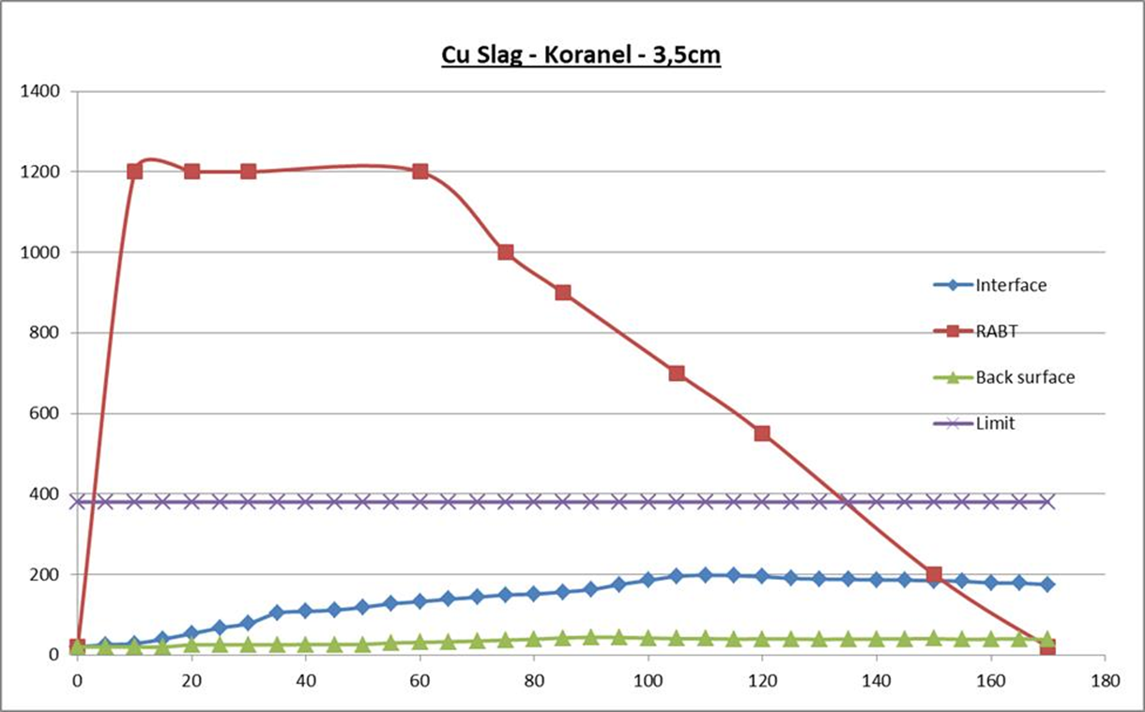
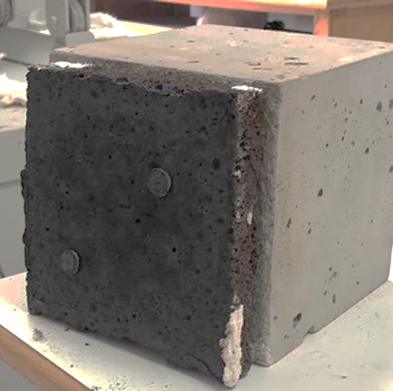
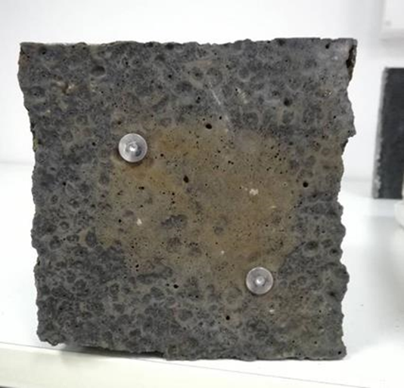
Materials Properties
Compressive strength = 5 MPa
Apparent Density = 1080 kg/m³
Composite Specimen
Max temperature at the concrete/geolopolymer interface is 200 °C which lower than the test success limit of 380 °C
40cm
Geopolymer Lining
Rectangular Specimen
40 x 40 cm
with Thickness 3,5cm
Concrete Substrate
Rectangular Specimen
40 x 40 cm
with Thickness 15cm
Magnification at high contrast
No Damages
No cracks
Temperature gradient : 33 °C/mm
40cm
Temperature gradient :
30 °C/mm
15cm
3,5cm
Before Fire Test
After Fire Test

Slide 15




Competition & Procurement Cost of Materials
Companies dominating the market of fire resistant materials
Promatect®T | PassiveTec® Pro | Aestuver T® | Tecbor®
22 – 42 €/m²
Geopfire
10 – 18 €/m²

Slide 16
Conclusions
Both slags as well as any Fayalitic slag from other metallurgical sectors such as ferroalloys production are very good precursors for production of Fire Resistant Geopolymers for passive fire protection of concrete constructions
Both slags give excellent materials for protection of concrete from cellulosic fires (ISO-834)
The Metallo slag after modification (doping with alumina) gave excellent material for protection of concrete from more severe fire scenarios like the RABT one
The same can happen with the Boliden slag after chemical modification applying the proprietary methodology of GEOVALIN, a Greek Spin-off established for commercializing fire resistant geopolymers

